Slide 1

Flood prediction using machine learning
SHIV KIRTI SOLANKI
APD3F2302CS(DA)
SUPERVISED BY : Dr. Dewi Octaviani
2ND MARKER : Dr. Masrina Akmal Binti Salleh (Ms.)

Slide 2
Problem statement
Floods have diverse impacts on individuals and communities, including psychological, financial, and environmental effects, influenced by factors like flood location and intensity.
Floods are vital for ecological balance, connecting ecosystems and aiding species propagation, but they can also disrupt ecosystems in severe cases.
Challenges in flood prediction using machine learning include limited, confidential data sources, data quality issues, process complexity, model interpretability, and regional perspective.
Flood damage can result in long-term consequences, disrupting essential services and causing economic vulnerability in communities.
Flood survivors, especially children, may experience lasting trauma due to displacement and disruptions to daily life.

Slide 3
Aim
Machine learning algorithms may be used to examine meteorological data, sea levels, and other key information to anticipate when a flood is probable.
Flood damage mitigation: Flood prediction using machine learning can also assist decrease flood damage.
Enhancing infrastructure: Flood prediction models may also be used to construct more flood-resistant infrastructure.

Slide 4
Objectives
To determine suitable methodology, techniques, and tools to build flood prediction models.
Try different preprocessing techniques and determining the best one.
To build flood prediction models using machine learning techniques.
To evaluate the flood prediction models using various assessment metrics and approaches to assure their correctness.
To deploy the flood prediction best model in a simple website.

Slide 5
Functionalities
Upon entering the website, you'll find interactive graphs that display data patterns, helping you understand the information better.
Scroll down to locate the data entry form on the website. Input accurate weather-related data, including temperature, rainfall, and wind speed.
website will process your data in the background to ensure it's ready for prediction
Click the "Predict" button to receive the flood prediction. 1 indicates a flood risk, while 0 suggests a low likelihood of flooding.
you can click "Exploratory Data Analysis" to access additional graphs and gain insights into the dataset.

Slide 6
Domain Research
Machine learning aids in rural flood prediction, utilizing data from water bodies, topography, and drainage systems to assess risks and minimize casualties.
Weather stations are crucial for providing timely response to floods, thereby fostering economic growth and sustainable infrastructure development in urban areas.
Advanced techniques like the Cascade Forest Model (CFM) improve flood susceptibility mapping accuracy.
CFM employs decision trees to classify features, providing reliable flood predictions for risk assessment.

Slide 7
Technical Research
Programming language was python
IDEs used were Python Juypter, Syder, Pycharm
Libraries were all installed and imported into Juypter
Web browsers used were Firefox, Google Chrome, Edge

Slide 8
Observations
Data Completeness.
Data Distribution.
Correlation analysis.
Data transformation.
Feature Selection.
Model Performance.
Visualization.

Slide 9
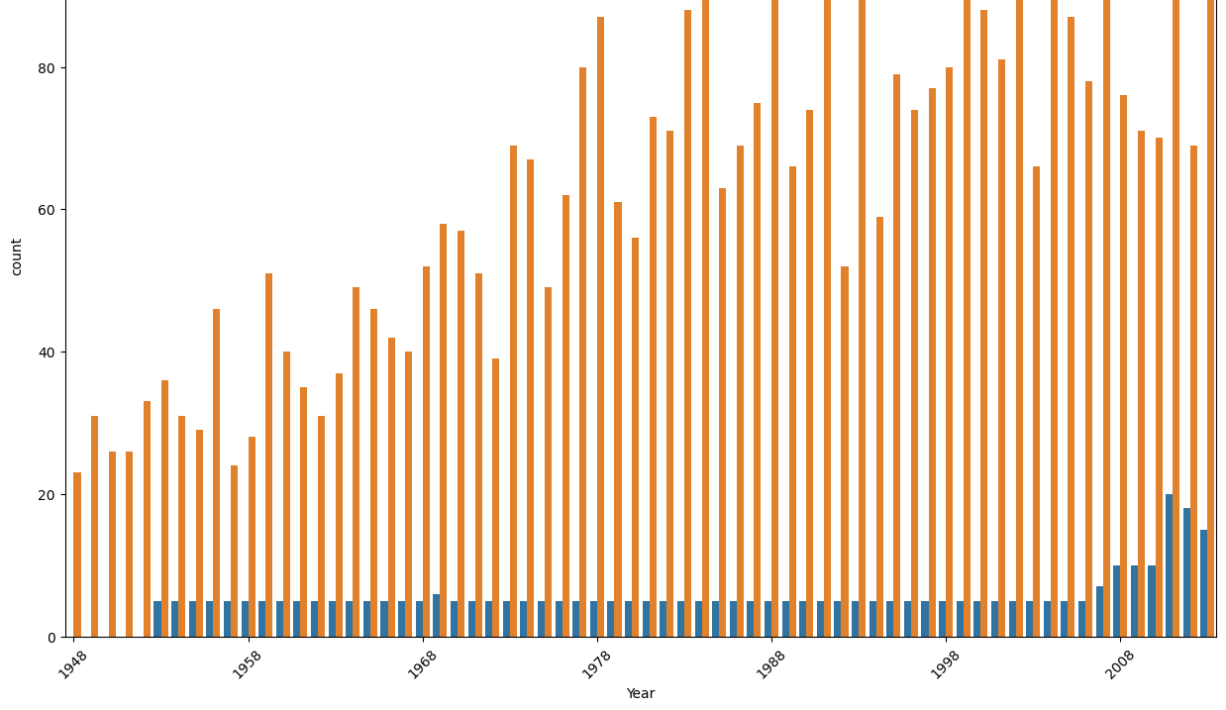
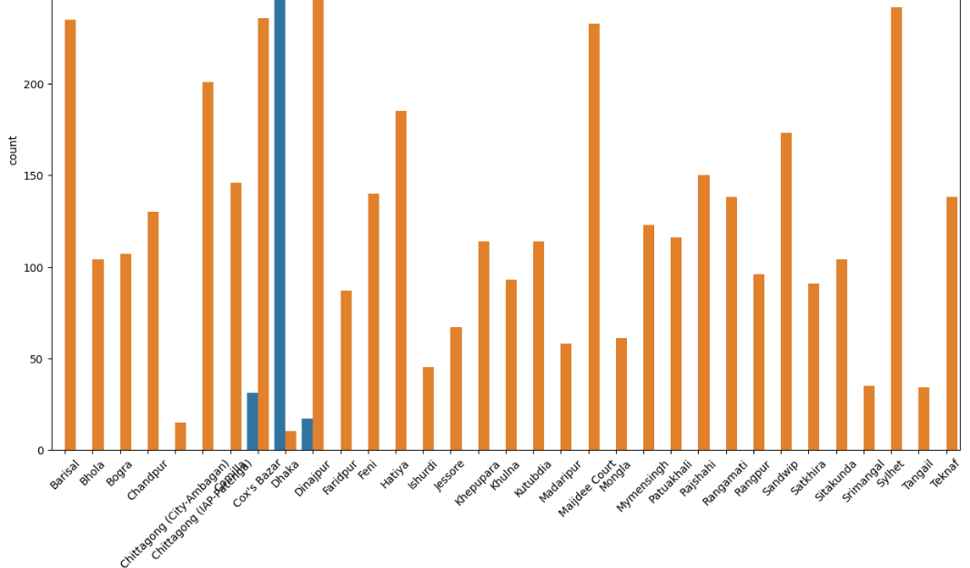
Visualizations

Slide 10
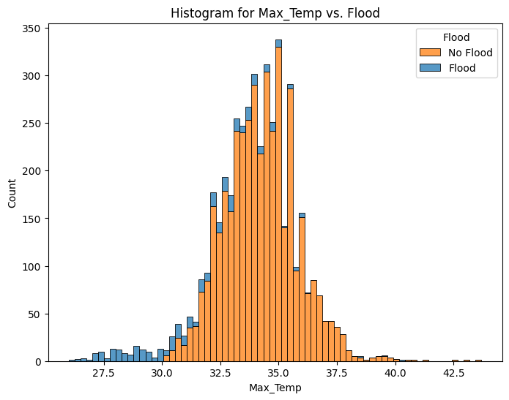
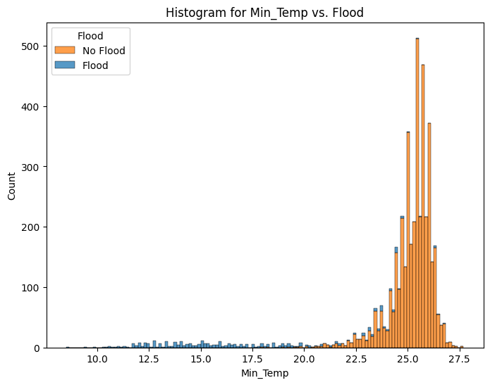
Visualizations

Slide 11
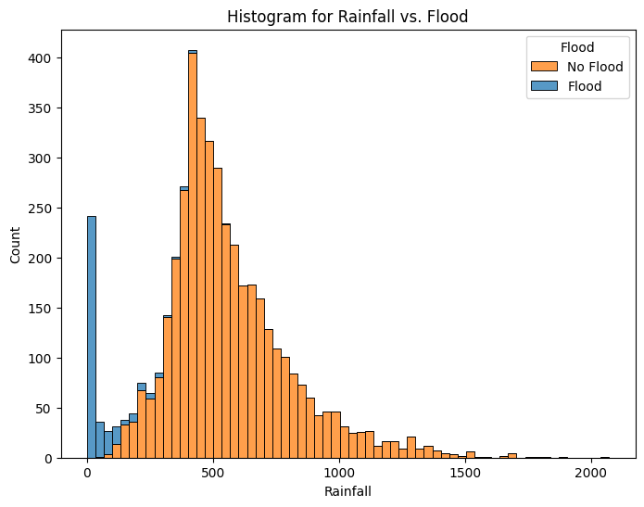
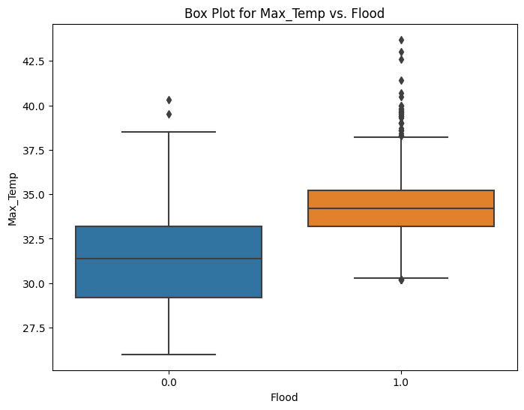
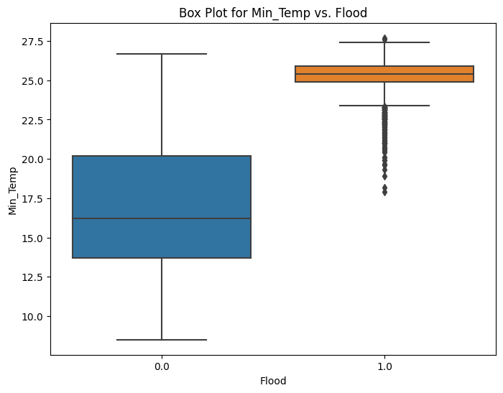
Visualizations

Slide 12
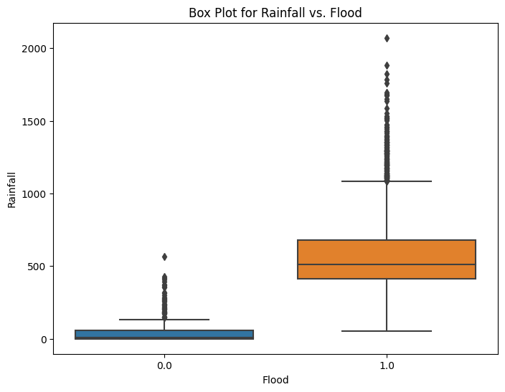
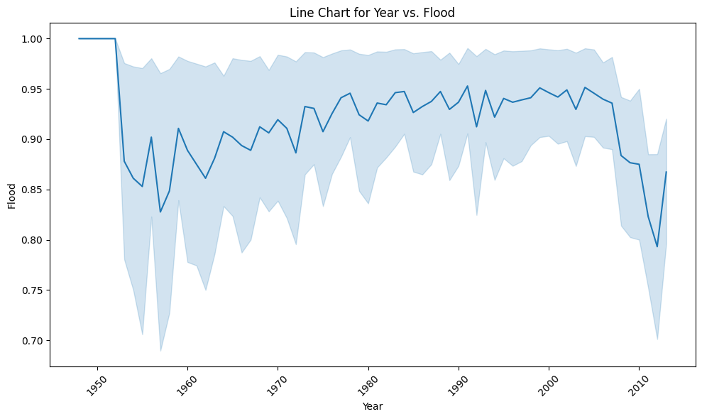
Visualizations

Slide 13
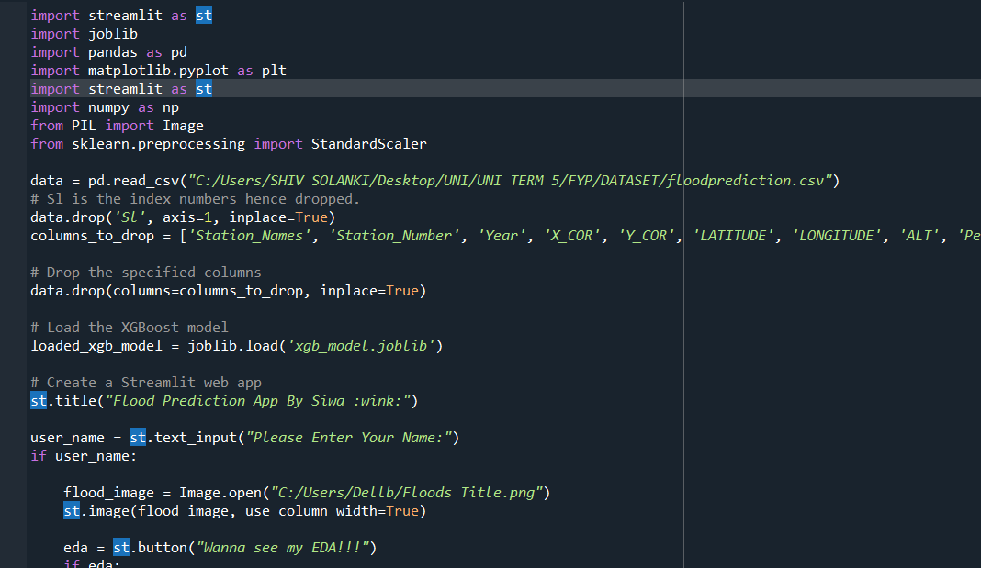
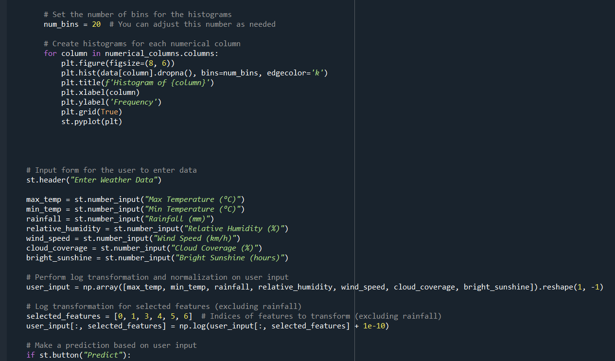
Deployment Code

Slide 14
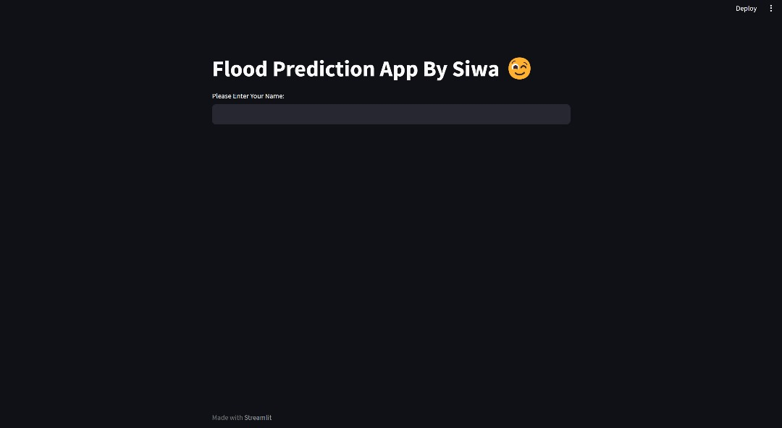
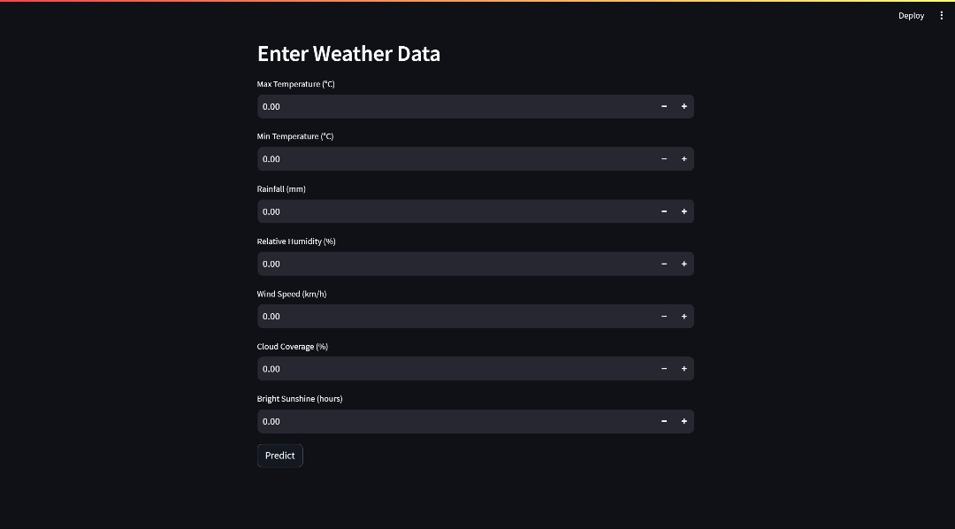

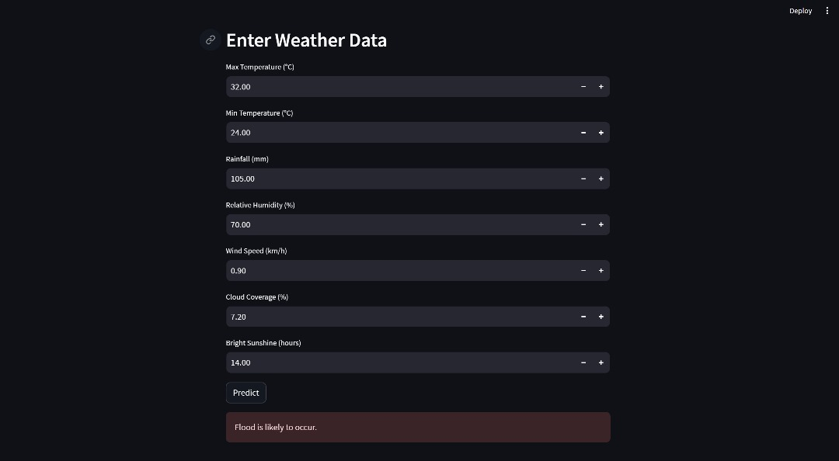
Deployment Interface

Slide 15
Problems and limitations
Imbalanced Dataset: Heavy imbalance between Flood and No Flood instances necessitated the use of under-sampling and over-sampling techniques to balance the dataset.
Skewed Feature: The "Rainfall" feature with a narrow value range or skew significantly impacted model predictions.
Data Inconsistencies: High levels of data inconsistencies were observed, leading to biased predictions.
Comprehensive Approach: Hyperparameter tuning, feature importance analysis, model selection, data splitting, preprocessing, and appropriate evaluation metrics were applied to finalize the deployment of the framework.

Slide 16
Future enhancements
Enable real-time data integration for up-to-the-minute flood predictions.
Enhance feature engineering and selection techniques.
Implement ensemble models for prediction accuracy.
Experiment with deep learning, including CNNs and RNNs.
Engage communities for data collection and validation.
Integrate with disaster management systems.

Slide 17
Conclusion
Learned a lot of python programing.
Learnt new machine learning techniques.
Learnt a lot about Floods.
Got used to the anaconda environment.

Slide 18
Questions and Answers time!
Q & A

